Slide 1
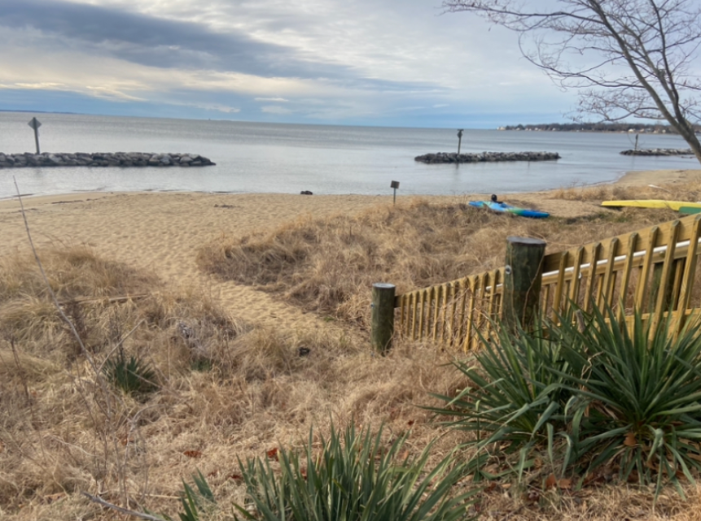
BRCA General Meeting
3.10.2025

Slide 2
Agenda
Call to order/Check for Quorum
Secretary Report - Approve Feb Minutes
Treasury Report
Membership Update
Newsletter Update
Security Update
Committee Reports
Old Business
New Business
Announcements

Slide 3
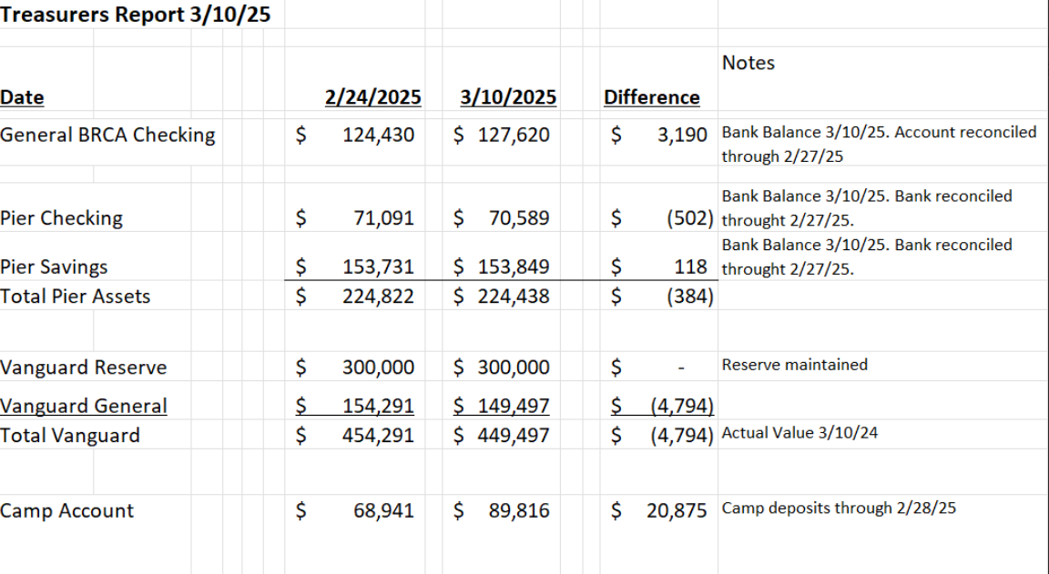
Treasurer Report

Slide 4
Finance Committee
Regarding investment portfolio: Committee has developed BRCA investment policy guidelines for board review. BRCA is in process of transferring funds to a more 'user' friendly platform, Charles Schwab.
Regarding insurance: Committee is developing BRCA insurance policy guidelines, plans to meet with the insurance broker and assessing cost benefit of various levels of coverage considering that insurance is one of the association's most significant cost items.
2024 Income Taxes: return is in process of preparation, once complete, committee will review prior to filing

Slide 5
New Business Topics
Board Nominating Committee
  Steve O’Hare (Chair), Meredith Carroll & Jill Whitall
  We need a slate of 5 candidates for April Elections
Capital Project update
Erosion Control Committee Drone surveys of beaches
Dogs off leashes
Gas Powered leaf Blowers
Deer Culling option for off-season

Slide 6
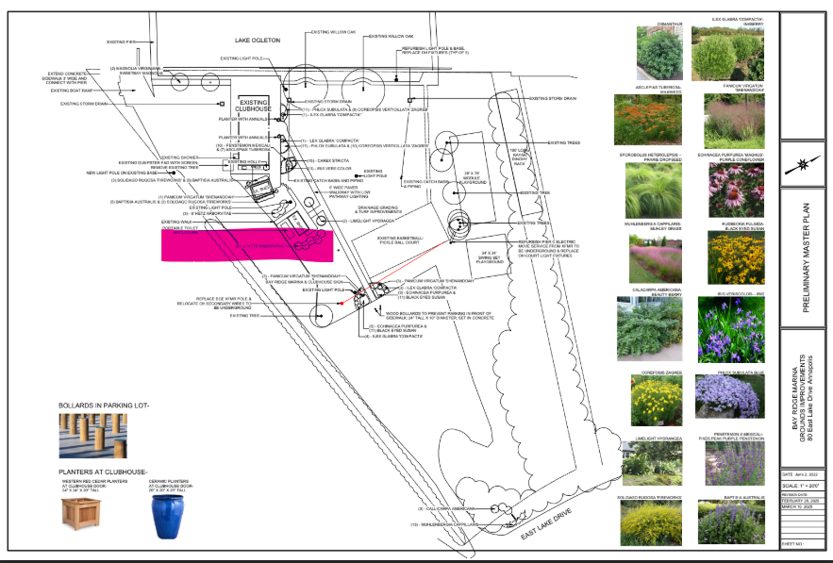
Capital Project

Slide 7
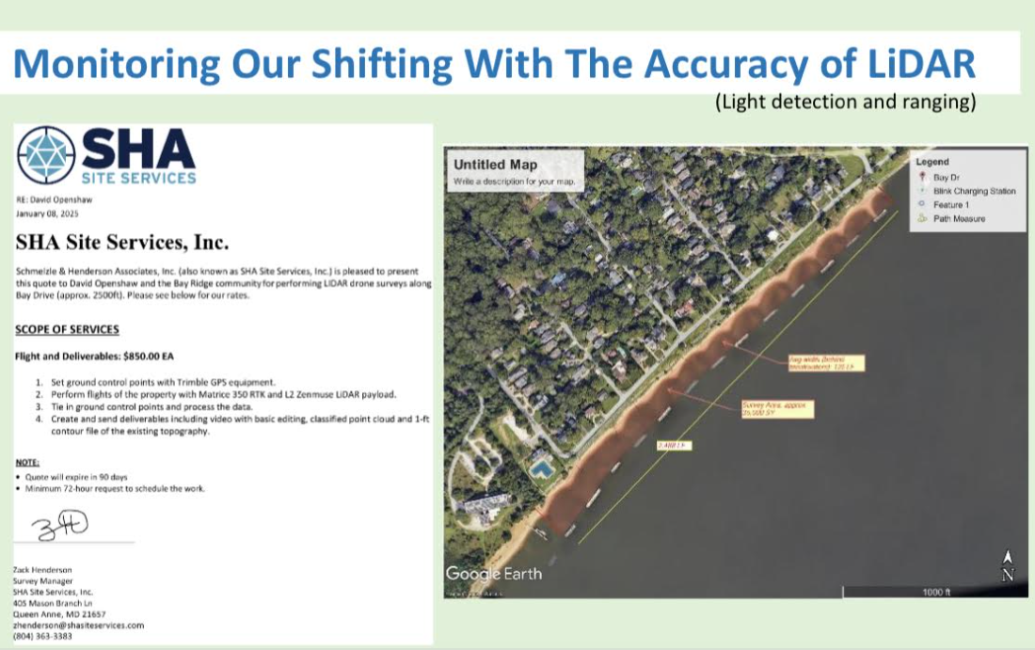
Erosion Control

Slide 8
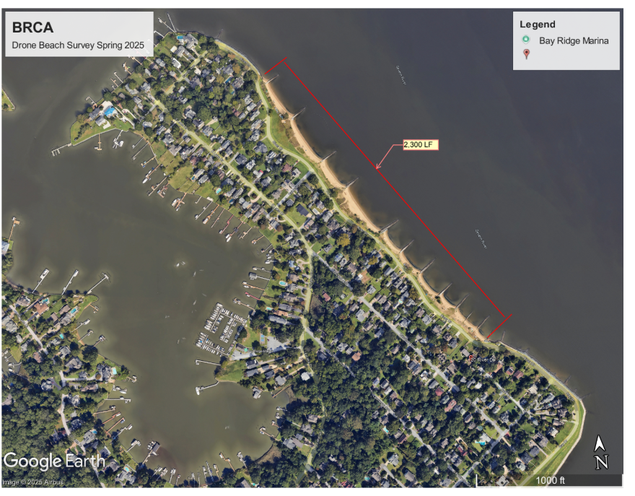
Erosion Control

