Slide 1
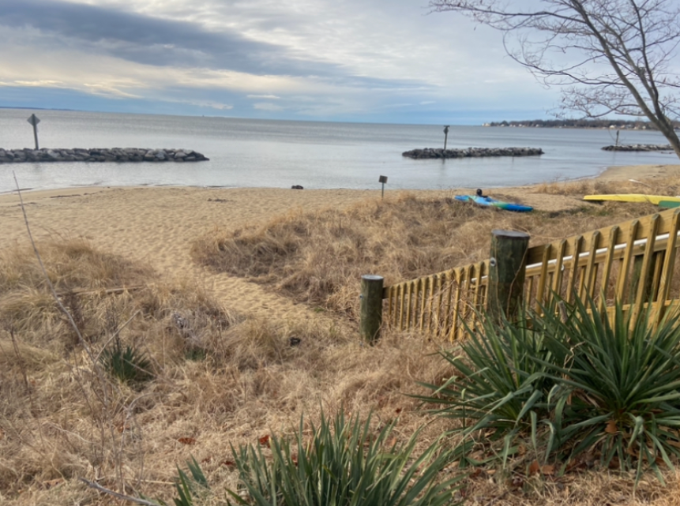
BRCA General Meeting
4.14.2025

Slide 2
Agenda
Call to order / Quorum present
Reading of the minutes
Report of the Treasurer
Reports of the Committees
Old Business
New Business
• Board Elections
• FMC Proposal to extend deer management activities year-round
Announcements
Adjournment

Slide 3
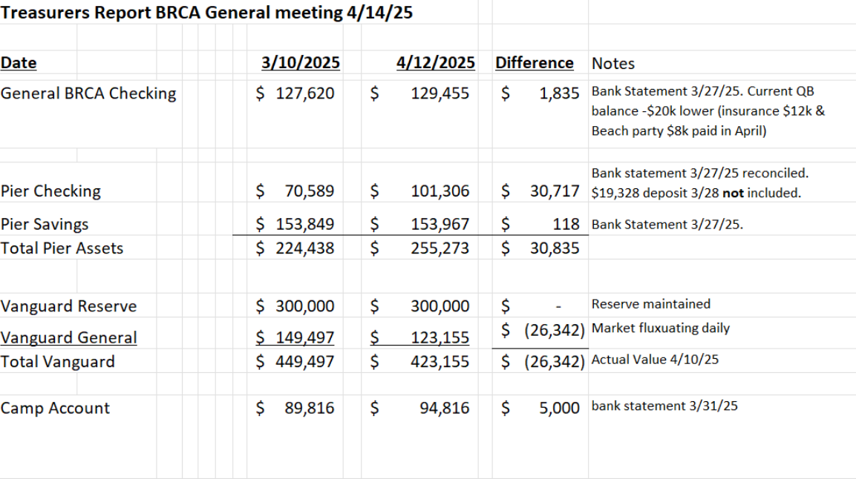
Treasurer Report

Slide 4
Reports of Committees
Membership
Finance
Security
Forest Management
Erosion Control
Pier
Commons
Social
Zoning
Kids Camp
Pool

Slide 5
New Business Topics
Board Elections
Deer Management Proposal for year-round culling

Slide 6
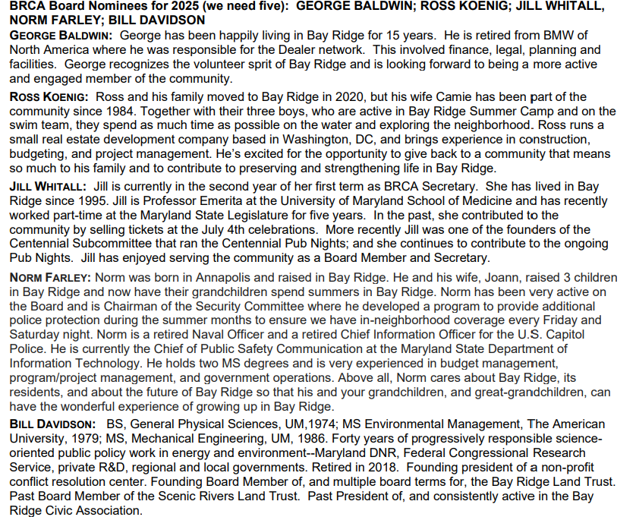
Slate for 2025

Slide 7
Deer Management Proposal for year-round
PROPOSED MOTION: Authorize the BRCA to manage deer activities year-round in the BRCA Big Woods in accordance with applicable laws and regulations.

Slide 8
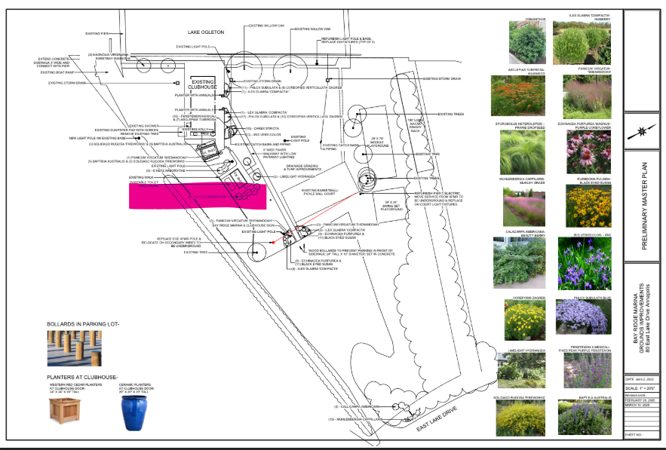
Capital Project

Slide 9
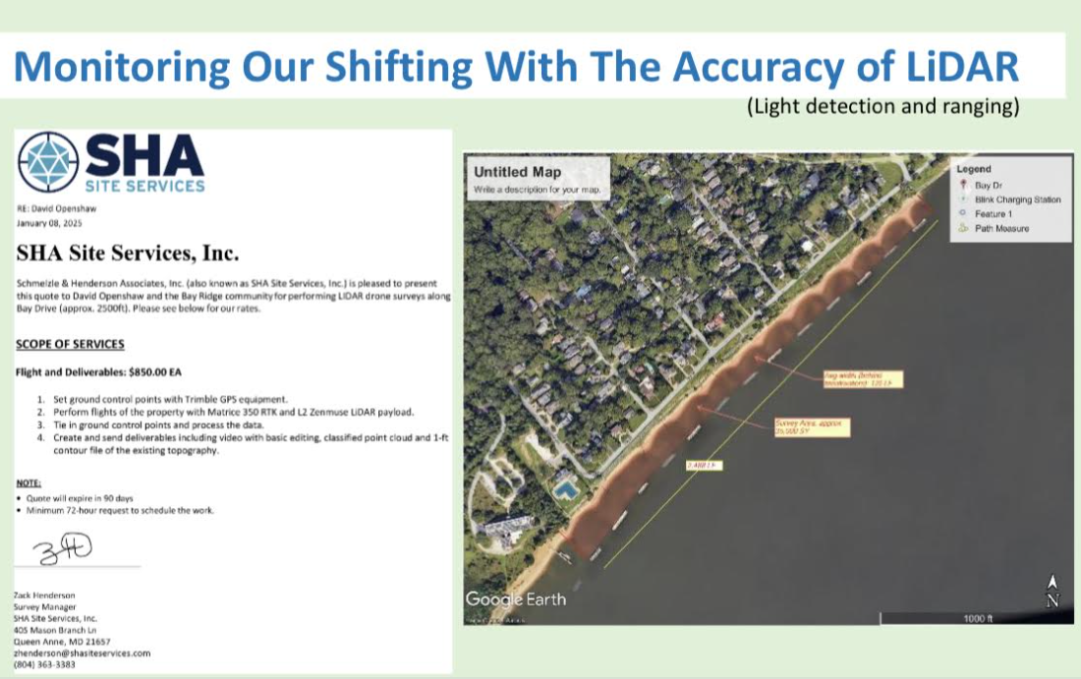
Erosion Control

Slide 10
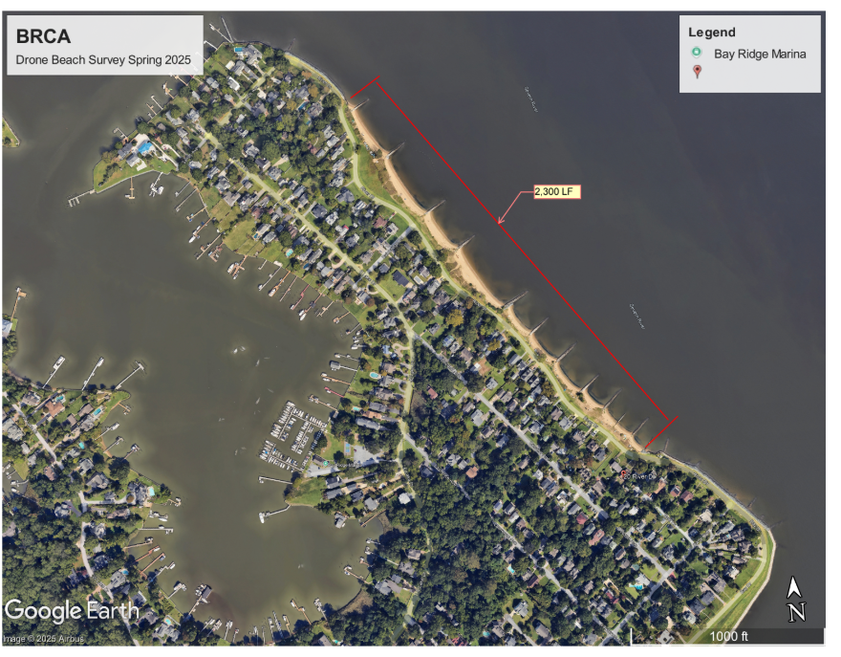
Erosion Control

